Slide 1
Chapter 5
AD HOC WIRELESS NETWORKS

Slide 2
5.1 Introduction
The history of ad hoc wireless network

Slide 3
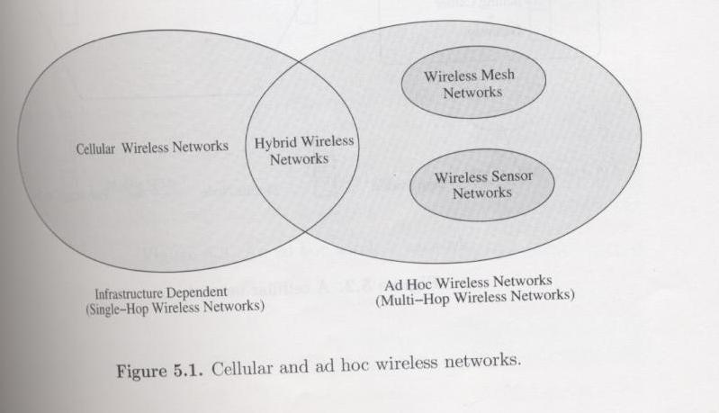
5.1.1 Cellular and Ad Hoc Wireless Networks
本圖取自"Ad Hoc Wireless Networks", by C. Siva Ram Murthy and B. S. Manoj, published by Prentice Hall, 2004

Slide 4
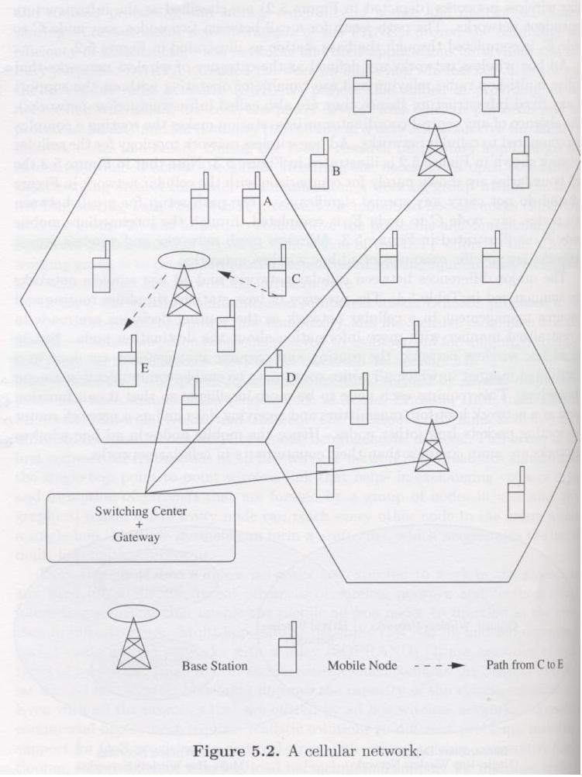
本圖取自"Ad Hoc Wireless Networks", by C. Siva Ram Murthy and B. S. Manoj, published by Prentice Hall, 2004

Slide 5
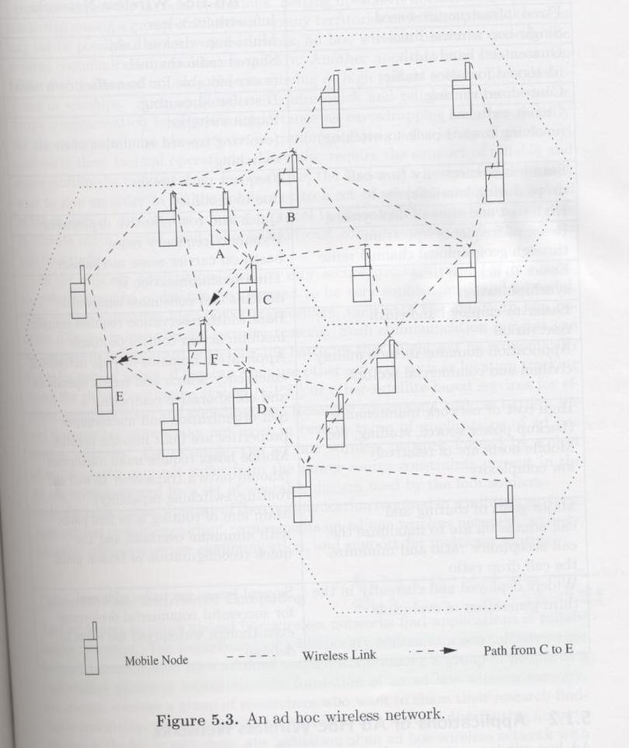
本圖取自"Ad Hoc Wireless Networks", by C. Siva Ram Murthy and B. S. Manoj, published by Prentice Hall, 2004

Slide 6
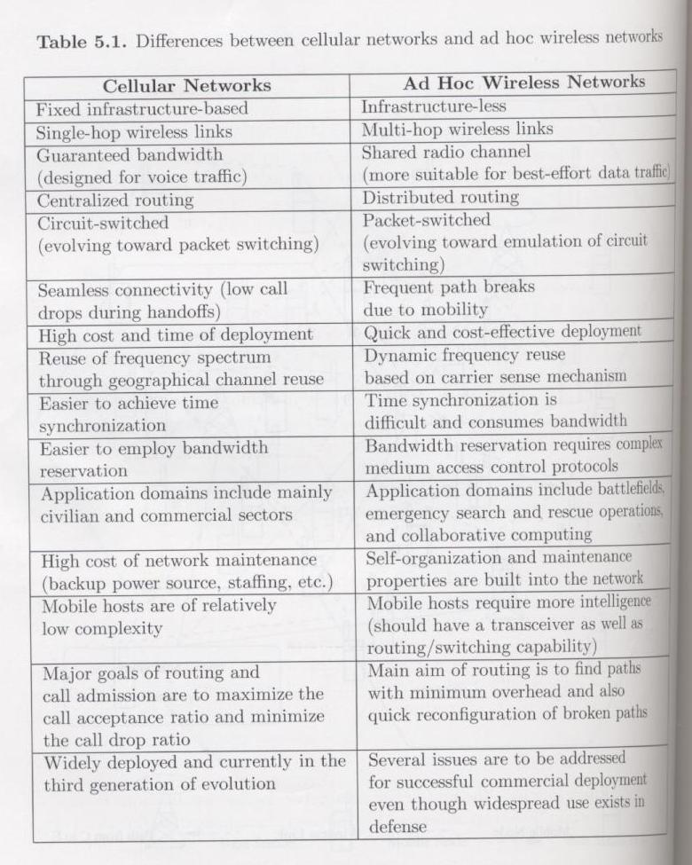
本圖取自"Ad Hoc Wireless Networks", by C. Siva Ram Murthy and B. S. Manoj, published by Prentice Hall, 2004

Slide 7
5.1.2 Applications of Ad Hoc Wireless Networks
Military Applications
Collaborative and Distributed Computing
Emergency Operations

Slide 8
5.1.2 Applications of Ad Hoc Wireless Networks (Cont.)
Wireless Mesh Networks
  An alternative of infrastructure for wireless network
  Deployment scenarios
    residential zones
    highways
    business zones
    important civilian regions
    university campuses
  Major advantages
    high data rate
    quick and low cost of deployment
    enhanced services
    high scalability , high avaiability
    easy extendability , low cost per bit

Slide 9
5.1.2 Applications of Ad Hoc Wireless Networks (Cont.)
Wireless Mesh Networks (Cont.)
  operate at license-free ISM bands 2.4GHz ~ 5GHz
  data rate of 2Mps to 60Mbps can be supported
  Properties
    Incremental deployment or partial batch deployment can be done
    Deployment or data tx cost is economical
    Location service
    At region with high density of nodes, throughput and user numbers can be enhanced

Slide 10
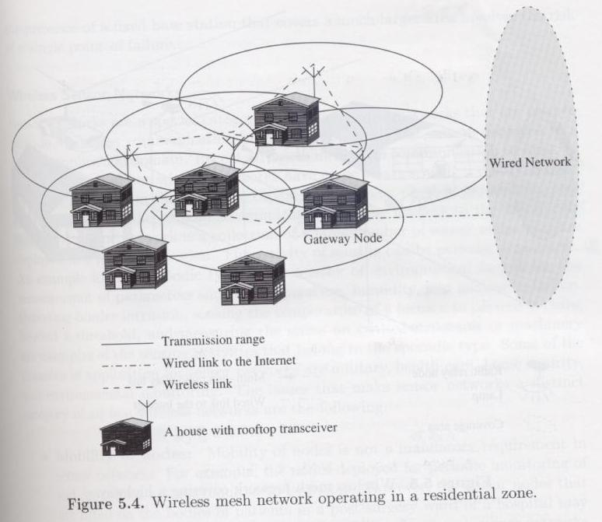
5.1.2 Applications of Ad Hoc Wireless Networks (Cont.)
本圖取自"Ad Hoc Wireless Networks", by C. Siva Ram Murthy and B. S. Manoj, published by Prentice Hall, 2004

Slide 11
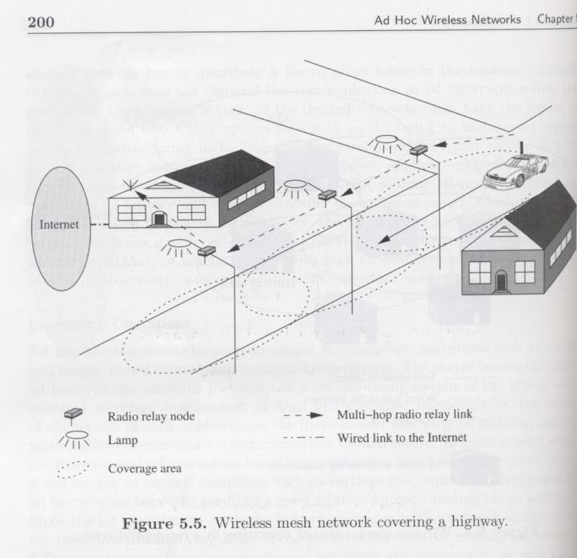
5.1.2 Applications of Ad Hoc Wireless Networks (Cont.)
本圖取自"Ad Hoc Wireless Networks", by C. Siva Ram Murthy and B. S. Manoj, published by Prentice Hall, 2004

Slide 12
5.1.2 Applications of Ad Hoc Wireless Networks (Cont.)
Wireless Sensor Networks
  A sensor network is a collection of a large number of sensor nodes that are deployed in a particular region
  Issues
    Mobility of nodes
    Size of the network
    Density of deployment
    Power constraints
    Data/information fusion
    Traffic distribution

Slide 13
5.1.2 Applications of Ad Hoc Wireless Networks (Cont.)
Hybrid Wireless Networks
  Multi-hop cellular networks (MCNs), integrated cellular ad hoc relay (iCAR) networks
  The capacity of a cellular network can be increased if the network incorporates the properties of multi-hop relaying along with the support of existing fixed infrastructure
  Major advantages
    High capacity due to increasing power range by cooperation with mobile nodes
    Flexibility. We can find best suitable nodes for routing
    Reliability. When one BS fail, we can link to another BS through multi-hop
    Better coverage and connectivity

Slide 14
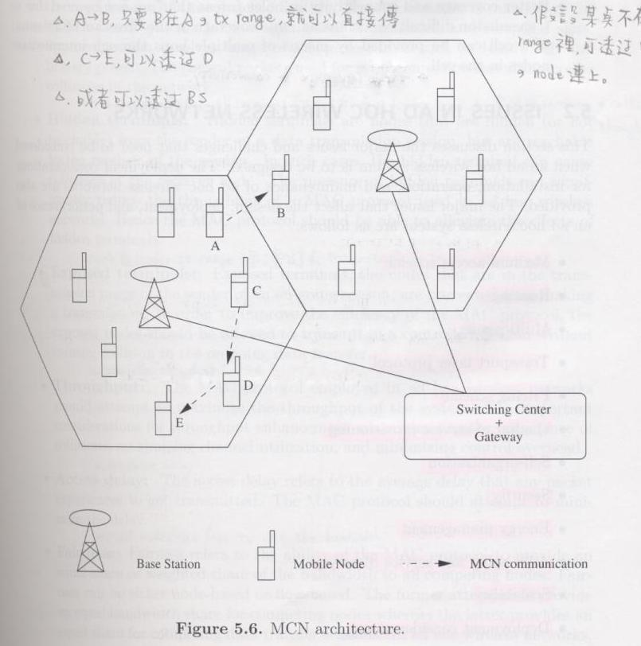
本圖取自"Ad Hoc Wireless Networks", by C. Siva Ram Murthy and B. S. Manoj, published by Prentice Hall, 2004

Slide 15
5.2 Issues in Ad Hoc Wireless Networks
Medium access scheme
Routing
Multicasting
Transport layer protocol
Pricing scheme
Quality of service provisioning
Self-organization
Security
Energy management
Addressing and service discovery
Scalability
Deployment considerations

Slide 16
5.2.1 Medium Access Scheme
The primary responsibility of a MAC protocol in ad hoc wireless network is the distributed arbitration for the shared channel for transmission of packets

Slide 17
5.2.1 Medium Access Scheme (Cont.)
Major issues in medium access scheme
  Distributed operation
  Synchronization
  Hidden terminals, exposed terminals
  Throughput
  Access delay
  Fairness

Slide 18
5.2.1 Medium Access Scheme (Cont.)
Major issues in medium access scheme
  Real-time traffic support
  Resource reservation
  Ability to measure resource availability
  Capability for power control
  Adaptive rate control
  Use of directional antennas

Slide 19
5.2.2 Routing
Routing’s responsibilities
  Exchanging the route information
  Finding a feasible path
  Gathering information about path breaks
  Mending the broken paths
  Utilizing minimum bandwidth
Major challenges for routing protocol
  Mobility
  Bandwidth constraint
  Error-prone and shared channel
  Location-dependent contention

Slide 20
5.2.2 Routing (Cont.)
Major requirements of a routing protocol in ad hoc
  Minimum route acquisition delay
  Quick route reconfiguration
  Loop-free routing
  Distributed routing approach
  Minimum control overhead
  Scalability
  Provisioning of QoS
  Support for time-sensitive traffic
  Security and privacy

Slide 21
5.2.3 Multicasting
Multicasting plays an important role in the typical applications of ad hoc wireless networks, namely, emergency search-and-rescue operations and military communication
Provisioning of multiple links among the nodes in ad hoc results in a mesh-shaped structure
The major issues in designing multicast
  Robustness
  Efficiency
  Control overhead
  Quality of service
  Efficient group management
  Scalability
  Security

Slide 22
5.2.4 Transport Layer Protocols
The main objectives of the transport layer protocols include setting up and maintaining end-to-end connections, reliable end-to-end delivery of data packets, flow control, and congestion control

Slide 23
5.2.5 Pricing Scheme
We need a pricing scheme for compensating relaying node for their consumption of resources such as battery charge and computing power

Slide 24
5.2.6 Quality of Service Provisioning
QoS is the performance level of services offered by a service provider or a network to the user
QoS parameters
QoS-aware routing
Qos framework

Slide 25
5.2.7 Self-Organization
One very important property that an ad hoc should exhibit is organizing and maintaining the network by itself
Major activities in self organization
  neighbor discovery
  topology reorganization
  topology organization

Slide 26
5.2.9 Addressing and Service Discovery
Each device in ad hoc wireless network should has unique address
With unique address for each device, location of each device and whole network configuration can be maintained
So we can discover the node offering service

Slide 27
5.2.10 Energy Management
Energy management can be classified into following categories
  Transmission power management
  Battery energy management
  Processor power management
  Devices power management

Slide 28
5.2.11 Scalability
When size of ad hoc wireless network growing up, there are some problems such as install, latency, periodic routing overhead
Hierarchical topology system can improve this problem

Slide 29
5.2.12 Deployment Considerations
The deployment of a commercial ad hoc wireless network has the following benefits comparing to wired networks
  Low cost of deployment
  Incremental deployment
  Short deployment time
  Reconfigurability

Slide 30
5.2.12 Deployment Considerations (Cont.)
Issues of considering deployment of ad hoc
  Scenario of deployment
  Required longevity of network
  Area of coverage
  Service availability
  Operational integration with other infrastructure
  Choice of protocols

Slide 31
5.3 Ad Hoc Wireless Internet
Ad hoc wireless internet extends the services of the internet to the end users over an ad hoc wireless networks
Some of the applications of ad hoc are wireless mesh networks

Slide 32
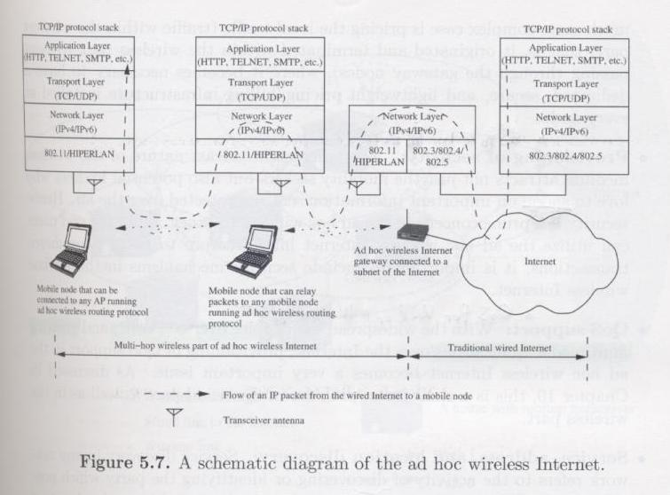
5.3 Ad Hoc Wireless Internet (Cont.)
“
本圖取自"Ad Hoc Wireless Networks", by C. Siva Ram Murthy and B. S. Manoj, published by Prentice Hall, 2004

Slide 33
5.3 Ad Hoc Wireless Internet (Cont.)
Issues in ad hoc wireless internet
  Gateways
  Address mobility
  Routing
  Transport layer protocol
  Load balancing
  Pricing/billing
  Provisioning of security
  QoS support
  Service, address, and location discovery

